Slide 1

Software Defined Network

Slide 2
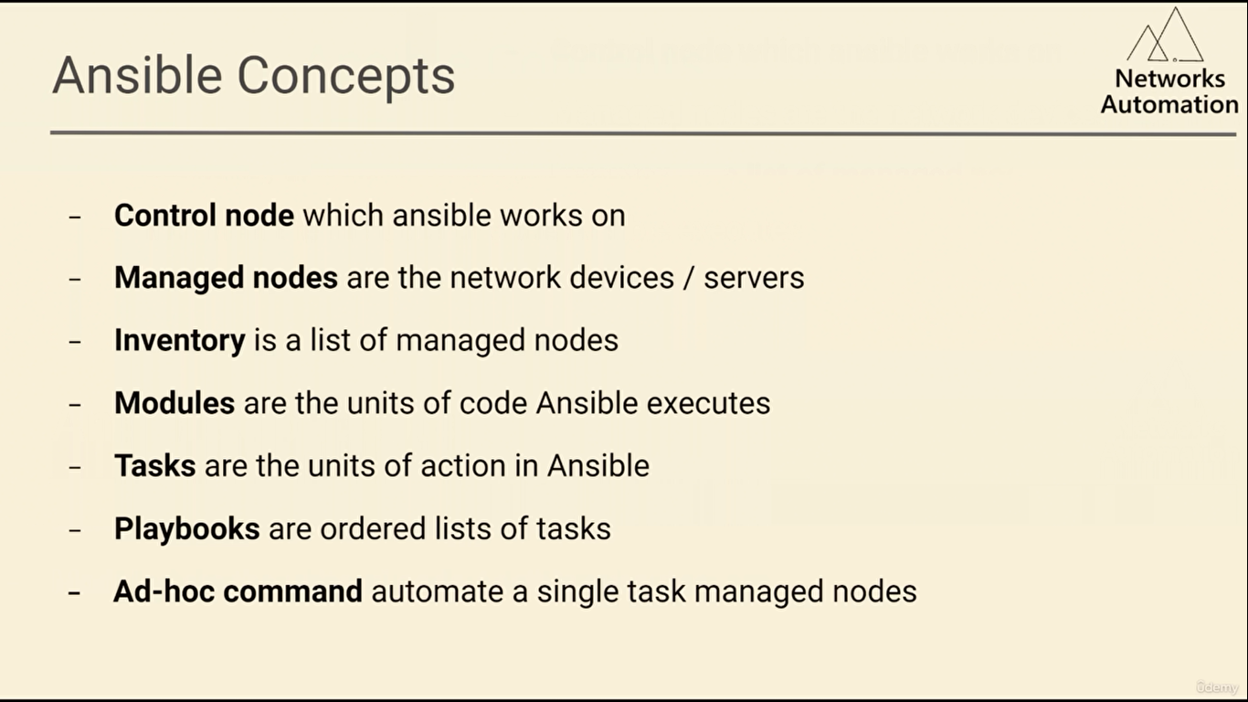

Slide 3
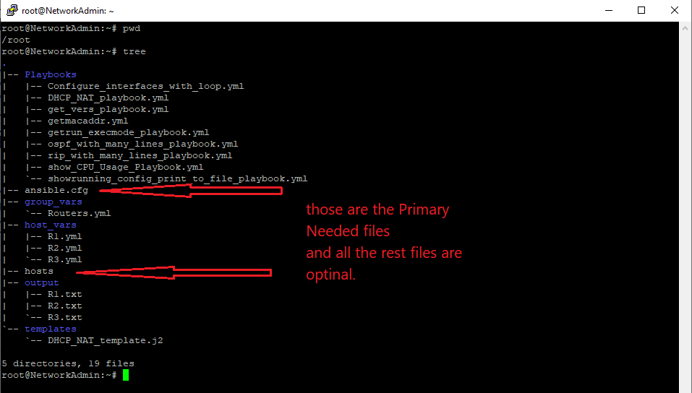

Slide 4
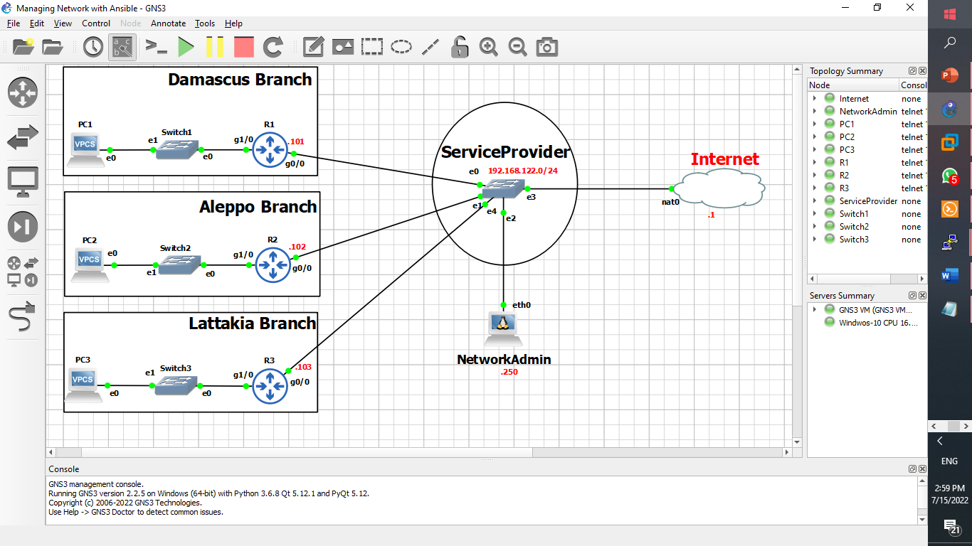
Practical Example of Ad-Hoc Commands Use:

Slide 5
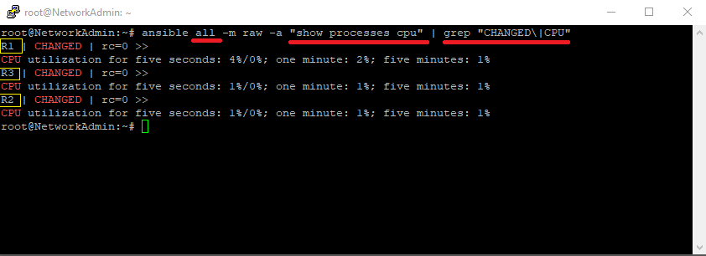
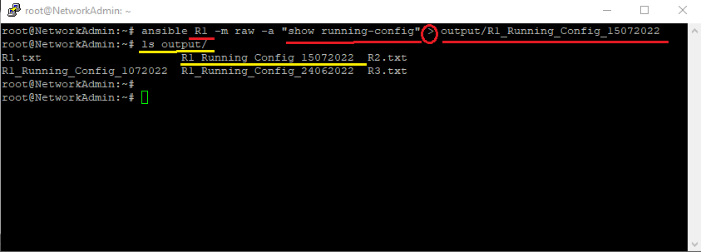
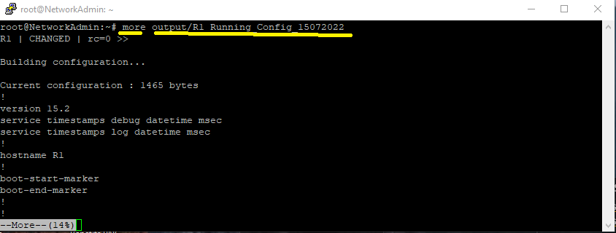

2) In this example, we pushed the command “show Processes cpu” to all hosts using SSH connection
and filtered the brought back result using grep to only look for specific info (CPU Utilization).
3) In this example, we pushed the command “show running-config” to host R1 using SSH connection
and redirected the output to a specific file to have a copy of the running configuration in that host.

Slide 6
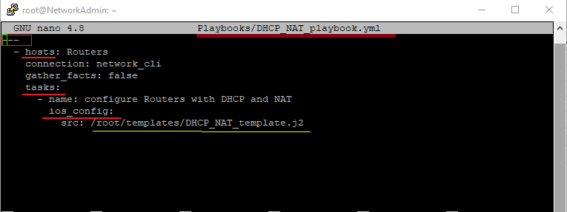
AAAAAASSSSSSSSSSSSSSSSSSSSSSSSSSSSSSSSSSSSSSSSSSSSSSSSSSSSSSSSSSSSSSSSSSSSSSSSSS
In this Playbook file, we specified:
Affected hosts to be all the hosts in the group “Routers”
One task in this play, with the name: Configure Routers with DHCP and NAT
And used the module: ios_config to push all the commands and their values from the template:
DHCP_NAT_template.j2 to the selected hosts.

Slide 7
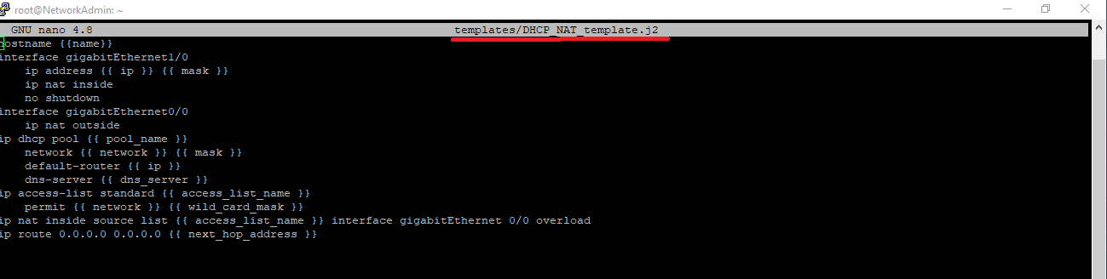
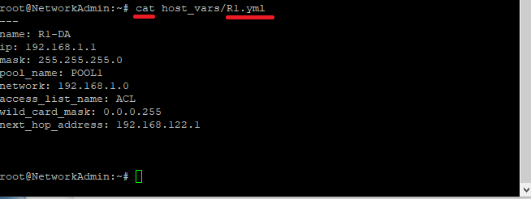
This is the Template we used in the Playbook (DHCP_NAT_Playbook.yml)
It can be applied to many hosts and groups of hosts at the same time and can scale up to have hundreds of commands…
Noting that the values of the variables {{ }} will be read from a variable file of each host
Example of Variables and their values for host R1
Defined in file: R1.yml

Slide 8
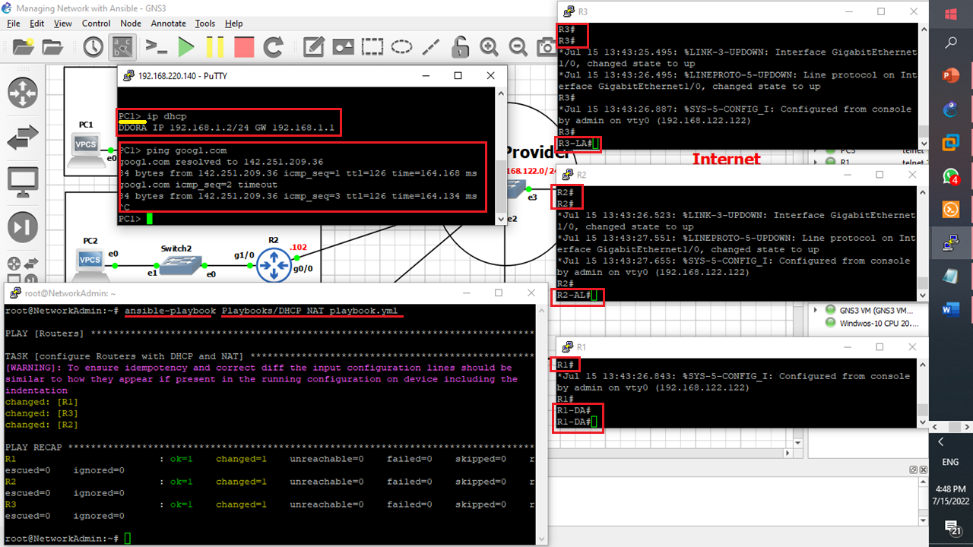
One Playbook activated DHCP and NAT on all our routers and allowed internet access to all end devices.

Slide 9
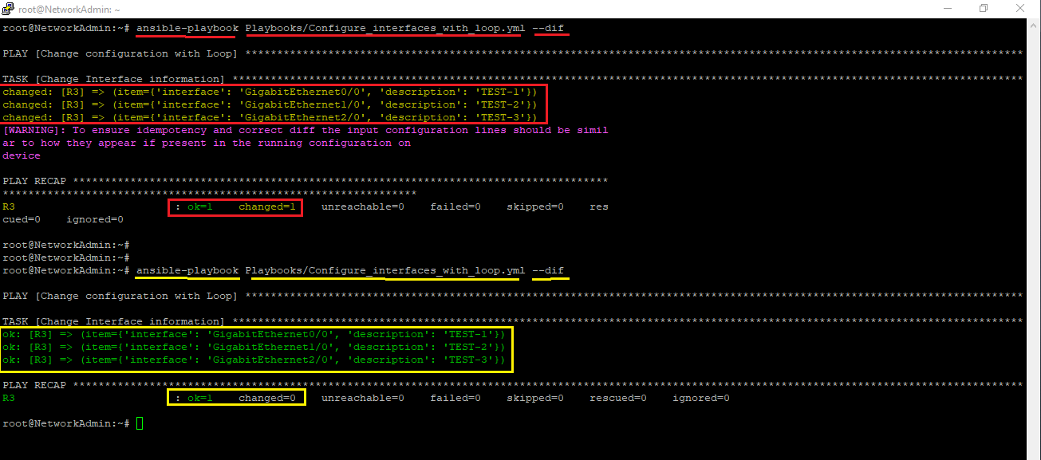
3rd Example:
Using the option –dif with a playbook will help us to get rid of configuration drifting problem
The 1st time we used it, changes were committed to R3 host and shown in the output (changed = 1)
- the 2nd time we used, no changes were committed as the commands in the playbook are already applied in the host (changed =0)

Slide 10

Future Prospects
The ability to schedule (using Linux Bash Scripts) the implementation or push of settings to network equipment within certain times and make it automated without the intervention of the network engineer.
Adding the feature of verifying the keys used in the SSH connection between the controller and network equipment to add greater security to the communication processes.
Integration of security and networking work so that the network engineer is responsible for programing routing and IP addressing, and he himself sets firewall rules.
Program the Control server to give periodic reports on the Transaction of network.
Set routers and switches to issue alerts when there is any modification to them other than Controller.
Take advantage of ZTP (Zero Touch Provisioning) technology, which allows network equipment to withdraw all its settings from the server device (Controller) by providing them using an option of DHCP options.

Slide 11


